Slide 1
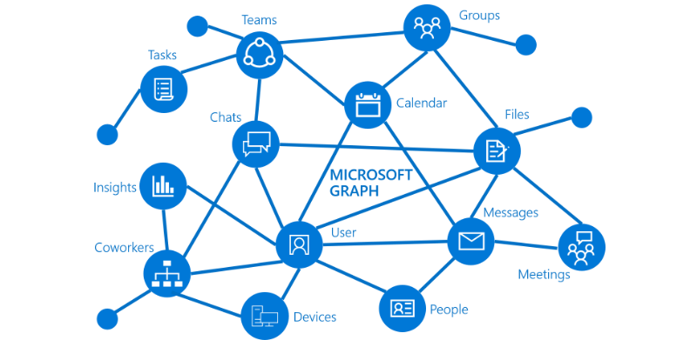
Maneuvering Your Way
to
Microsoft Graph API
Notes:
Some really good links we think simplifies a lot Graph:
https://www.one-tab.com/page/WQtmEp4rTCyg4gT_UluG0Q
http://bit.ly/2H2YHx9

Slide 2


TODAY’S
Speaker
Jocel Sabellano
Senior IT Consultant at Porcaro Stolarek Mete Partners, LLC
I write automations
github.com/theitrx
2

Slide 3
TODAY’S
Agenda
What is Microsoft Graph API
Overview of Microsoft Graph API
Benefits of knowing Graph
What applications or automations can you make with Graph
Authenticate to Graph API
Grant Types
Requesting a token
Request parameters
3

Slide 4
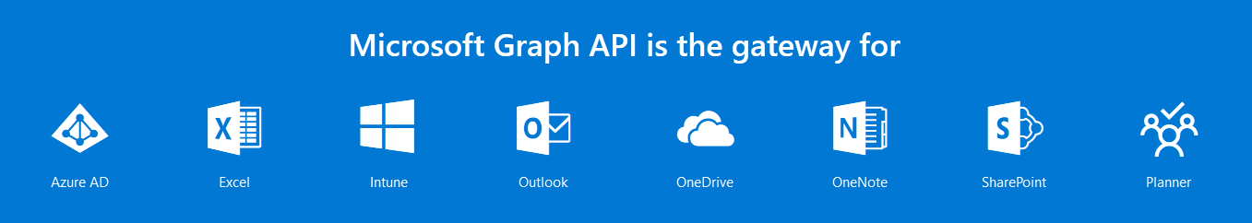
OVERVIEW OF MICROSOFT GRAPH API
WHAT IS MICROSOFT GRAPH
Is a REST API, a unified endpoint
That gives you access to
Azure AD
Excel
Intune
Outlook
Onedrive
Sharepoint
Planner
..and More!
And you can
Generate reports and audit data
Perform hundreds of tasks programmatically
Build automations or apps
..and more!
4
Notes:
Benefits:
. You are flexible with almost a lot of management tasks. There are a lot of things you can’t do in the portal that you can do with Graph
. You can process batches or numerous tasks in a short amount of time
. You can be more innovative to whatever you can come up with
. You’re awesome.
Sample applications:
. Automated onboarding of users
. Custom reporting
. Custom auditing
. Custom dashboard

Slide 5






Why is Microsoft Graph Important
What can you do with Microsoft Graph?
Manage Intune and AutoPilot
Backup your tenant’s entire Intune and AutoPilot configuration, compare backup sets and restore from an older configuration
Onboard users
Automate user onboarding workflows and manage changes to user roles within an organization.
Correlate security alerts
Use one API to access 9 Microsoft security services, Provide visibility into security data to enable proactive risk management, Invoke actions to in response to new threats and review your tenants Secure Scores
Integrate with Excel
Tap into Excel data to build powerful workflows that automate data collection.
Manage employee profiles
Manage employee information stored across various locations in the enterprise.
Reporting, Insights and Analytics
Integrate Office 365 usage reporting into your organization's existing reporting solution. View user analytics and enterprise insights
5
Notes:
Bring data from an external content source to Microsoft Graph (preview)
Use Microsoft Graph connectors to bring data that is external to the Microsoft cloud into Microsoft Graph. Examples of such data can be an organization's human resources database or product catalog, hosted on-premises or in the public or private clouds.
Microsoft Graph connectors create connections to external data sources, index the data, and store it as external custom items and files. Once indexed, those items can show up in Microsoft Search, and for apps that use the Microsoft Search API.
Access Microsoft Graph data at scale using Microsoft Graph data connect
Use Microsoft Graph data connect to access data on Microsoft Graph at scale, while allowing administrators granular consent and full control over their Microsoft Graph data. Data connect streamlines the delivery of this data to Microsoft Azure.
Using Azure tools, you can then build intelligent apps that:
Find you the closest expert on a topic to you in your organization
Automate knowledge base creation
Analyze meeting requests to provide insights into conference room utilization
Detect fraud with productivity and communication data
Enterprise insight example: trending docs in the org
SECURITY SERVICES
Azure Security Center
Azure Active Directory Identity Protection
Microsoft Cloud App Security
Microsoft Defender Advanced Threat Protection
Azure Advanced Threat Protection
Office 365Default alert policies
Cloud App Security
Azure Information Protection (preview)
Azure Sentinel (preview)

Slide 6




Why is Microsoft Graph Important
Microsoft Graph Stats
90%
of all Fortune 500 companies have data in Microsoft Graph
100B
Microsoft Graph requests every month
18T
resources (emails, events, users, files, groups, and more) in Microsoft Graph
180M
monthly active users of Office 365 commercial
6
Notes:
Here are some Microsoft stats relating to their Office 365 offering and why Graph is so valuable
https://view.officeapps.live.com/op/view.aspx?src=https://c.s-microsoft.com/en-us/CMSFiles/TranscriptFY20Q2.docx?version=9674fe79-64c1-95db-10c0-1015c4c70d3c

Slide 7
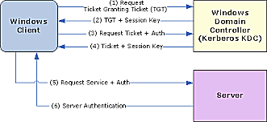
GRAPH VS PSSESSION
AUTHENTICATION
PSSESSION
Uses Active Directory or Local Account Creds
Username
Password
Types
CredSSP
Kerberos
Digest
PSCredential Object
7
Notes:
http://bit.ly/2RwJVlG
Kerberos is the default method of authentication when the client is in a domain and the remote destination string is not one of the following: localhost, 127.0.0.1, or [::1].
Negotiate is the default method when the client is not in a domain, but the remote destination string is one of the following: localhost, 127.0.0.1, or [::1].

Slide 8
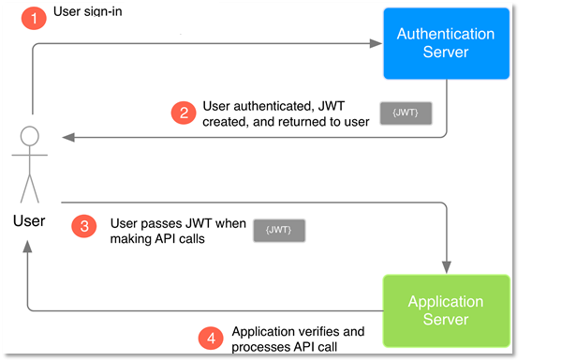
GRAPH VS PSSESSION
AUTHENTICATION
GRAPH API
HTTP
Azure AD Application
Application ID
Application Secret
Microsoft / Azure AD Account
Username
Password
JSON Web Token
Authentication code
Device code
8
Notes:
In general:
You authenticate and you get a token.
You get a token then you attach it as a body of your API request.
With right permission, grants, username/password, etc. You should be able to talk to Graph API endpoint.

Slide 9
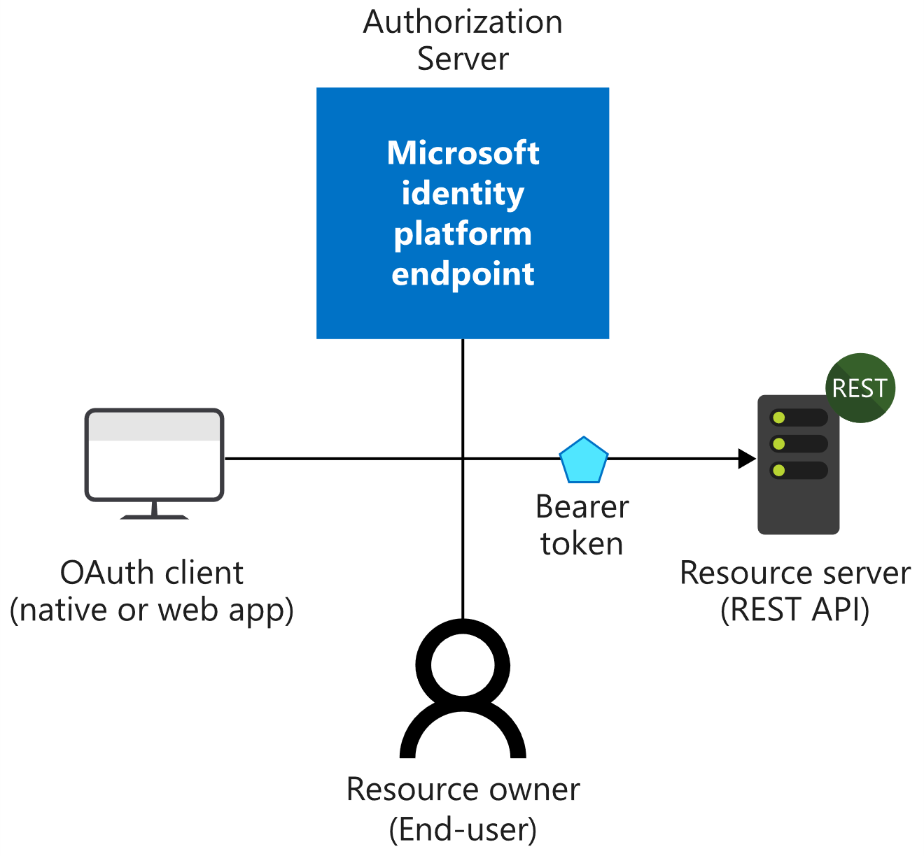
AUTHENTICATE TO GRAPH API
OBJECTS YOU NEED
Service Principal
Application ID/Secret
Directory (tenant) ID
Permissions
User or Admin Consent
AAD User Account Credentials
Access Token
Needed to Access Graph API
JSON Web Token (JWT)
URL - https://login.microsoftonline.com
/{TenantID}
/oauth2/v2.0/token
Graph API Endpoint
Where you will send your request
Root URL - https://graph.microsoft.com/v1.0/
Root URL - https://graph.microsoft.com/beta/
https://graph.Microsoft.com
/{version}
/{resource}
/{id}
/{property}
/{query-parameters}
9
Notes:
AAD app is the logical object of your app/automation. This works the same way as if you have a Facebook app. Permissions are assigned to your AAD App. It’s sort of the identity for your application within azure AD.
AAD App is the prerequisite to get access token. Access token is the prerequisite to talk to Graph API

Slide 10
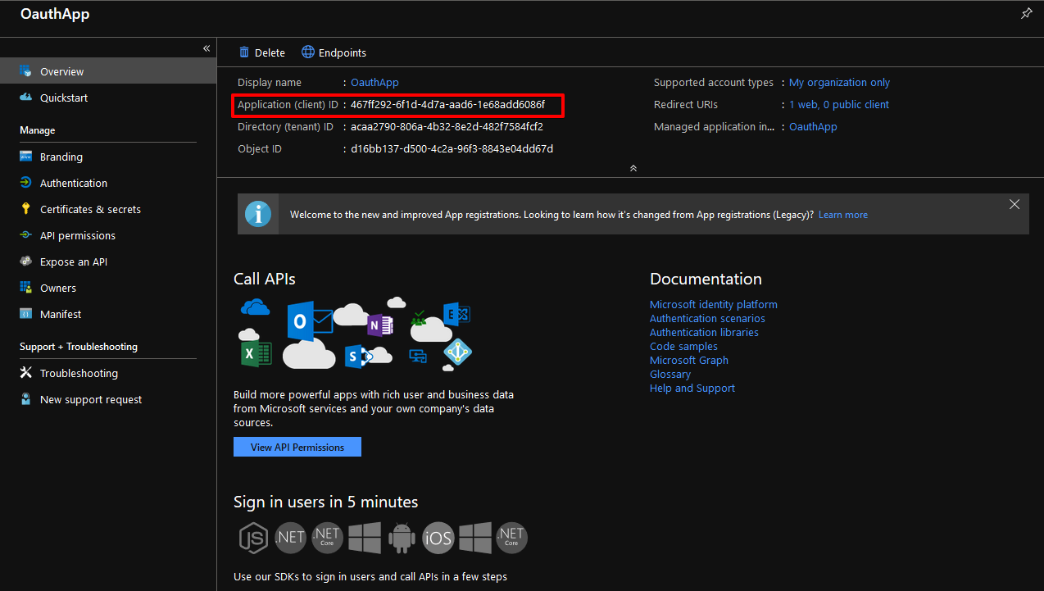
AUTHENTICATE TO GRAPH API
Service Principal
Azure AD Application
Application (client) ID
Application (client) Secret
Directory (tenant) ID
Permissions
User or Admin Consent
Azure AD User Account Credentials
10

Slide 11
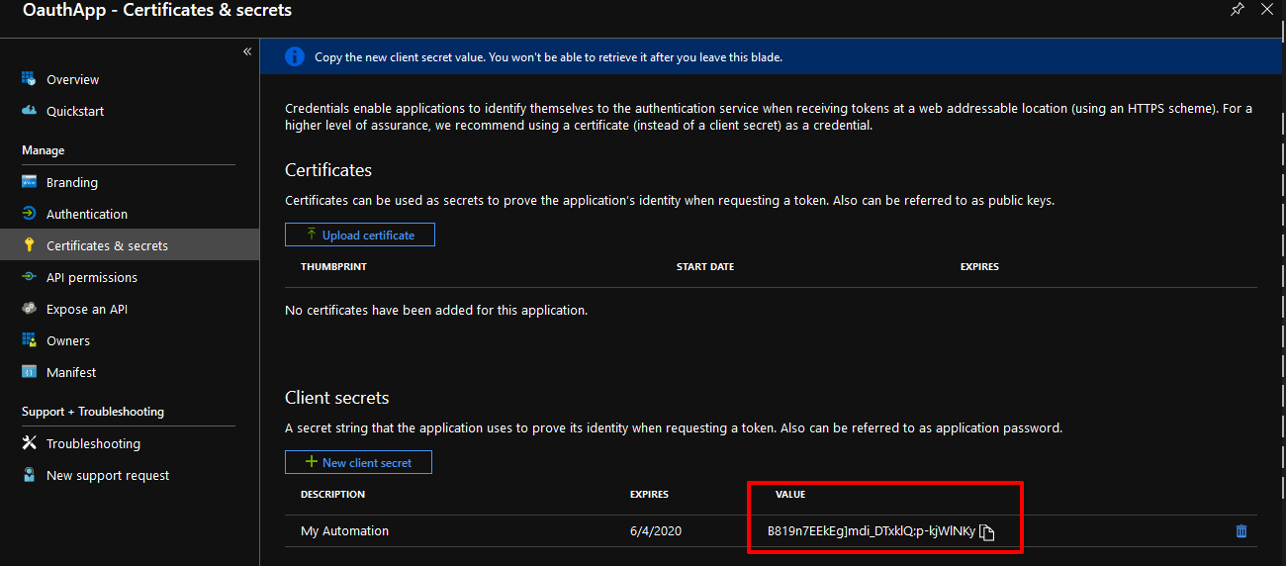
AUTHENTICATE TO GRAPH API
Service Principal
Azure AD Application
Application (client) ID
Application (client) Secret
Directory (tenant) ID
Permissions
User or Admin Consent
AAD User Account Credentials
11

Slide 12

AUTHENTICATE TO GRAPH API
Service Principal
Azure AD Application
Application (client) ID
Application (client) Secret
Directory (tenant) ID
Permissions
User or Admin Consent
Azure AD User Account Credentials
12

Slide 13
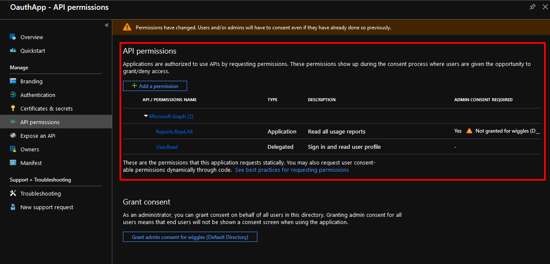
AUTHENTICATE TO GRAPH API
Service Principal
Azure AD Application
Application (client) ID
Application (client) Secret
Directory (tenant) ID
Permissions
User or Admin Consent
Azure AD User Account Credentials
13

Slide 14
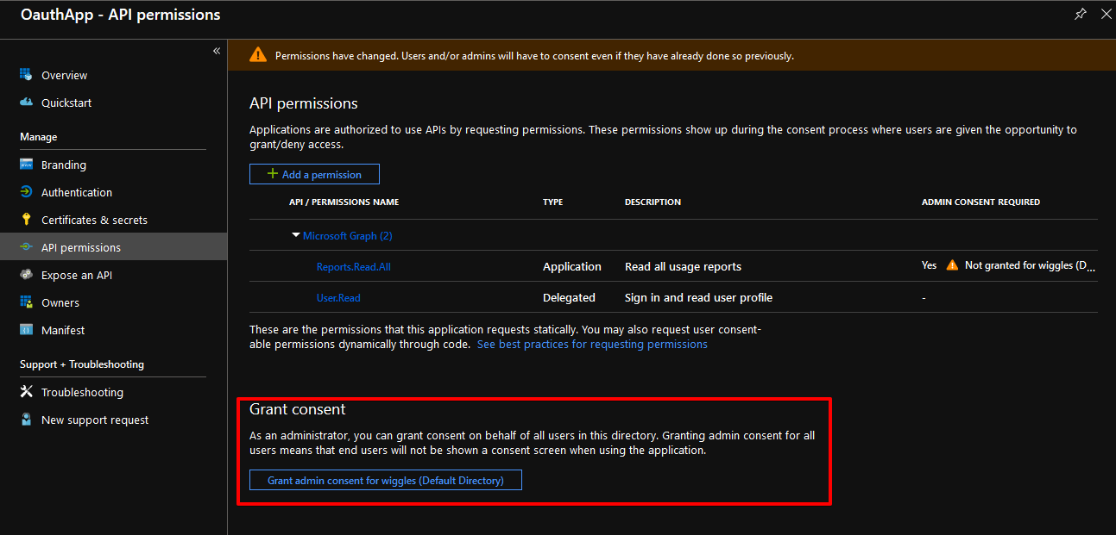
AUTHENTICATE TO GRAPH API
Service Principal
Azure AD Application
Application (client) ID
Application (client) Secret
Directory (tenant) ID
Permissions
User or Admin Consent
Azure AD User Account Credentials
14

Slide 15
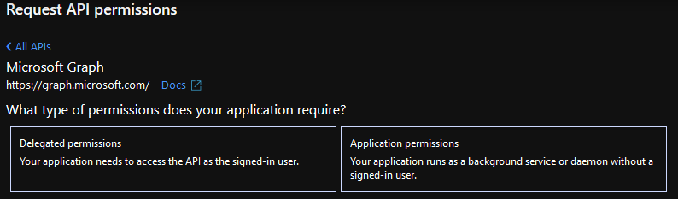
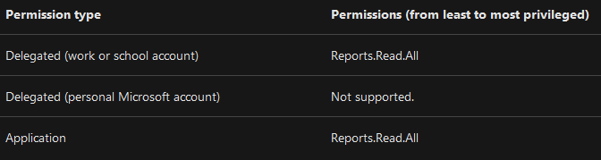
AUTHENTICATE TO GRAPH API
APP PERMISSIONS
Delegated
Resources that need user context
E.g. Sending email or message to teams
Needs user or admin consent
Access the API as the signed-in user.
Application
App-only – without a user
Best for daemon apps
Only admin can consent
15
Notes:
Delegated permissions - Are used by apps that have a signed-in user present. For these apps, either the user or an administrator consents to the permissions that the app requests and the app is delegated permission to act as the signed-in user when making calls to an API. Depending on the API, the user may not be able to consent to the API directly and would instead require an administrator to provide "admin consent".
Application permissions - Are used by apps that run without a signed-in user present; for example, apps that run as background services or daemons. Application permissions can only be consented by an administrator because they are typically powerful and allow access to data across user-boundaries, or data that would otherwise be restricted to administrators.
http://bit.ly/2RAGv1e

Slide 16
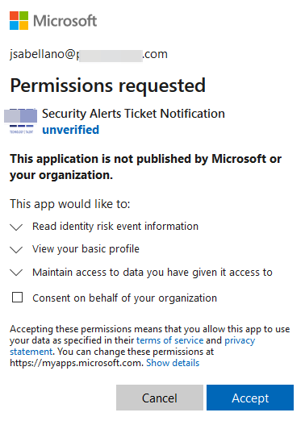
AUTHENTICATE TO GRAPH API
USER AUTH | ADMIN CONSENT
USER
https://login.microsoftonline.com
/{tenant}
/oauth2
/v2.0
/authorize
?client_id={client ID}
&response_type=code
&redirect_uri={Redirect URL in the Azure app}
&scope={permission.code} offline_access
&prompt=consent
16
Notes:
. Permissions won’t work without user or admin consent.
. User authorization is used for delegated permissions. Some endpoints need admin consent to work.
. Admin consent is needed on some app permissions.
http://bit.ly/2RAGiv7

Slide 17
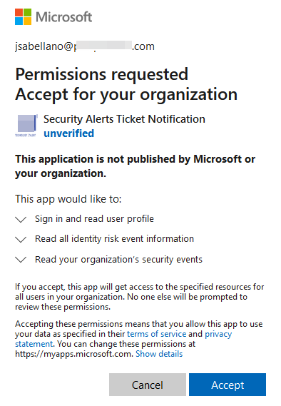
AUTHENTICATE TO GRAPH API
USER AUTH | ADMIN CONSENT
ADMIN
https://login.microsoftonline.com
/{tenant}
/adminconsent
?client_id={client ID}
&redirect_uri={Redirect URL in the Azure app}
17
Notes:
. Permissions won’t work without user or admin consent.
. User authorization is used for delegated permissions. Some endpoints need admin consent to work.
. Admin consent is needed on some app permissions.
http://bit.ly/2RAGiv7

Slide 18
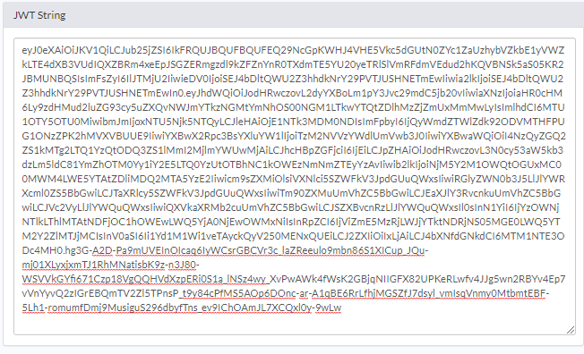
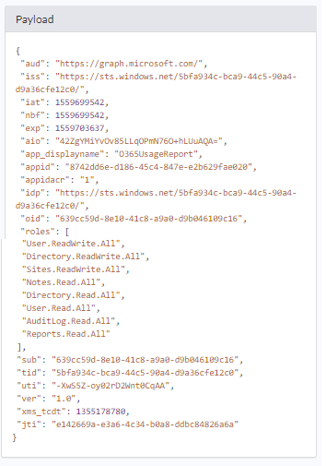
AUTHENTICATE TO GRAPH API
Access Token
Access Token
Needed to Access Graph API
JSON Web Token (JWT)
https://login.microsoftonline.com
/{Tenant ID | “common”}
/oauth2
/v2.0
/token
18
Notes:
JWT encoded. A signed base 64 string.
http://bit.ly/2RElFyb

Slide 19
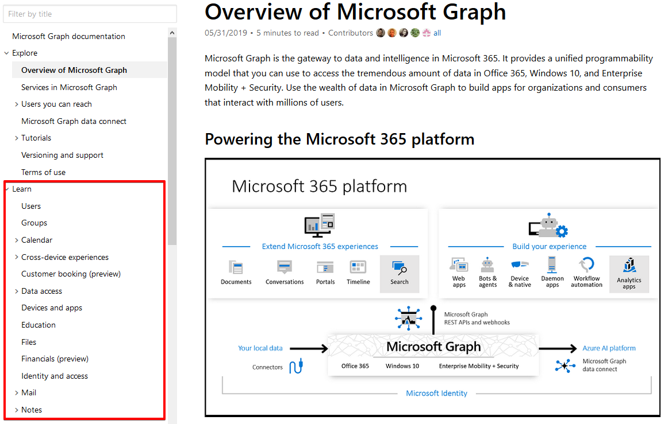
AUTHENTICATE TO GRAPH API
API Endpoint
How to Know the Endpoint?
https://docs.microsoft.com
/graph
/overview
Examples:
https://graph.microsoft.com/v1.0
Reports - /reports/
Audit Logs - /auditLogs/
Onedrive - /me/drive/
Mail Drafts - /me/mailfolders(‘Drafts’)/
Sharepoint - /sites/
19

Slide 20
AUTHENTICATE TO GRAPH API
GRANT TYPES
Client_Credentials
Password
Authorization_Code
Device_Code
Refresh_Token
20
Notes:
Grant types are chosen based off the way how you authenticate or acquire your access token.
All the Grant types and documentation:
http://bit.ly/2REuoAC

Slide 21
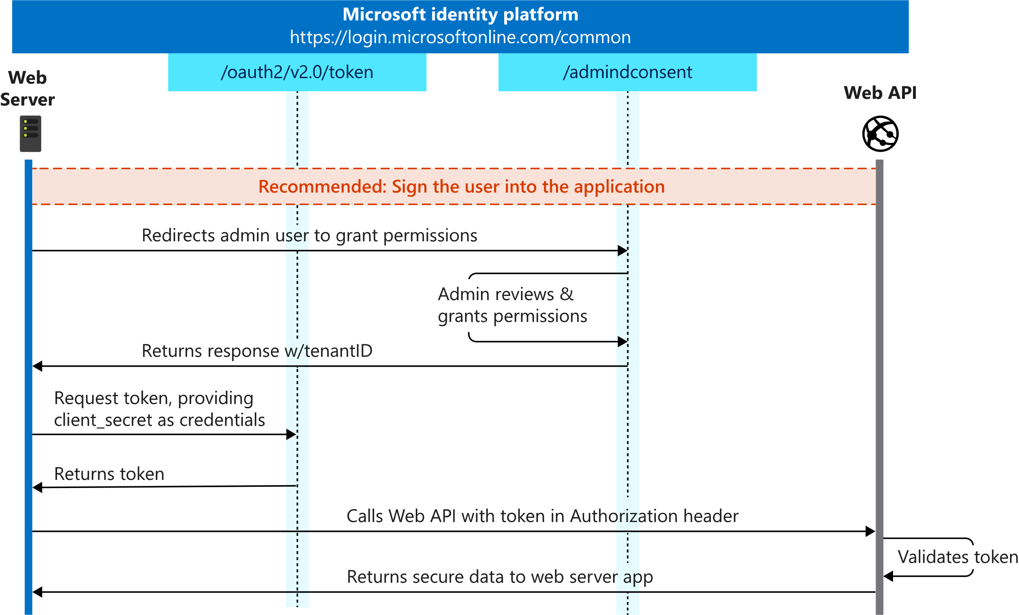
AUTHENTICATE TO GRAPH API
GRANT TYPES
Client_Credentials
Best used for daemon apps
Uses Azure AD App only for authentication
Application permissions are used
Token contains no user context
Needs admin consent for permissions
Required POST Body:
Grant_Type = Client_Credentials
Client_ID = “{Azure App Client ID}”
Client_Secret = “{Azure App Client Secret}”
Scope = https://graph.microsoft.com/.default
21
Notes:
Grant types are chosen based off the way how you authenticate or acquire your access token.
Documentation: http://bit.ly/2K0rswY
All the Grant types and documentation:
http://bit.ly/2REuoAC

Slide 22
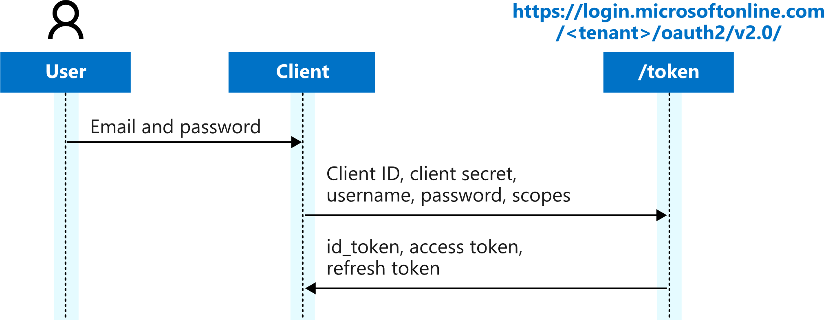
AUTHENTICATE TO GRAPH API
GRANT TYPES
Password
Token contains user context
Needs AAD user credentials
Can create a refresh token (Scope: Offline_Access)
Does not support web-based authentication (MFA)
Not recommended by Microsoft
Required POST Body:
Grant_Type = Password
Client_ID = “{Azure App Client ID}”
Client_Secret = “{Azure App Client Secret}”
Username = “{Username}”
Password = “{Password}”
Scope = https://graph.microsoft.com/{permission.code}
22
Notes:
Grant types are chosen based off the way how you authenticate or acquire your access token.
All the Grant types and documentation:
http://bit.ly/2REuoAC
Warning
Microsoft recommends you do not use the ROPC flow. In most scenarios, more secure alternatives are available and recommended. This flow requires a very high degree of trust in the application, and carries risks which are not present in other flows. You should only use this flow when other more secure flows can't be used.
Important
The Microsoft identity platform endpoint only supports ROPC for Azure AD tenants, not personal accounts. This means that you must use a tenant-specific endpoint (https://login.microsoftonline.com/{TenantId_or_Name}) or the organizations endpoint.
Personal accounts that are invited to an Azure AD tenant can't use ROPC.
Accounts that don't have passwords can't sign in through ROPC. For this scenario, we recommend that you use a different flow for your app instead.
If users need to use multi-factor authentication (MFA) to log in to the application, they will be blocked instead.
ROPC is not supported in hybrid identity federation scenarios (for example, Azure AD and ADFS used to authenticate on-premises accounts). If users are full-page redirected to an on-premises identity providers, Azure AD is not able to test the username and password against that identity provider. Pass-through authentication is supported with ROPC, however.

Slide 23
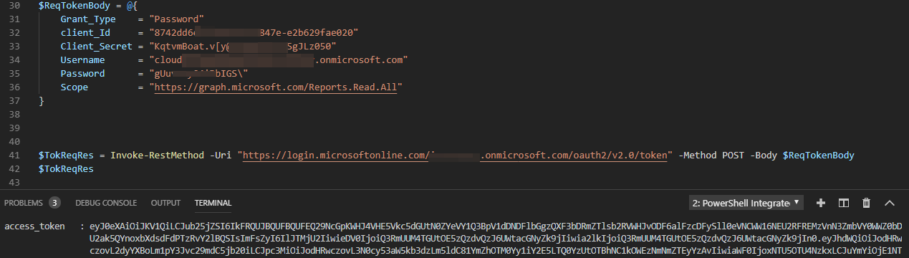
PASSWORD - STITCHING THE COMPONENTS
REQUESTING TOKEN
23

Slide 24
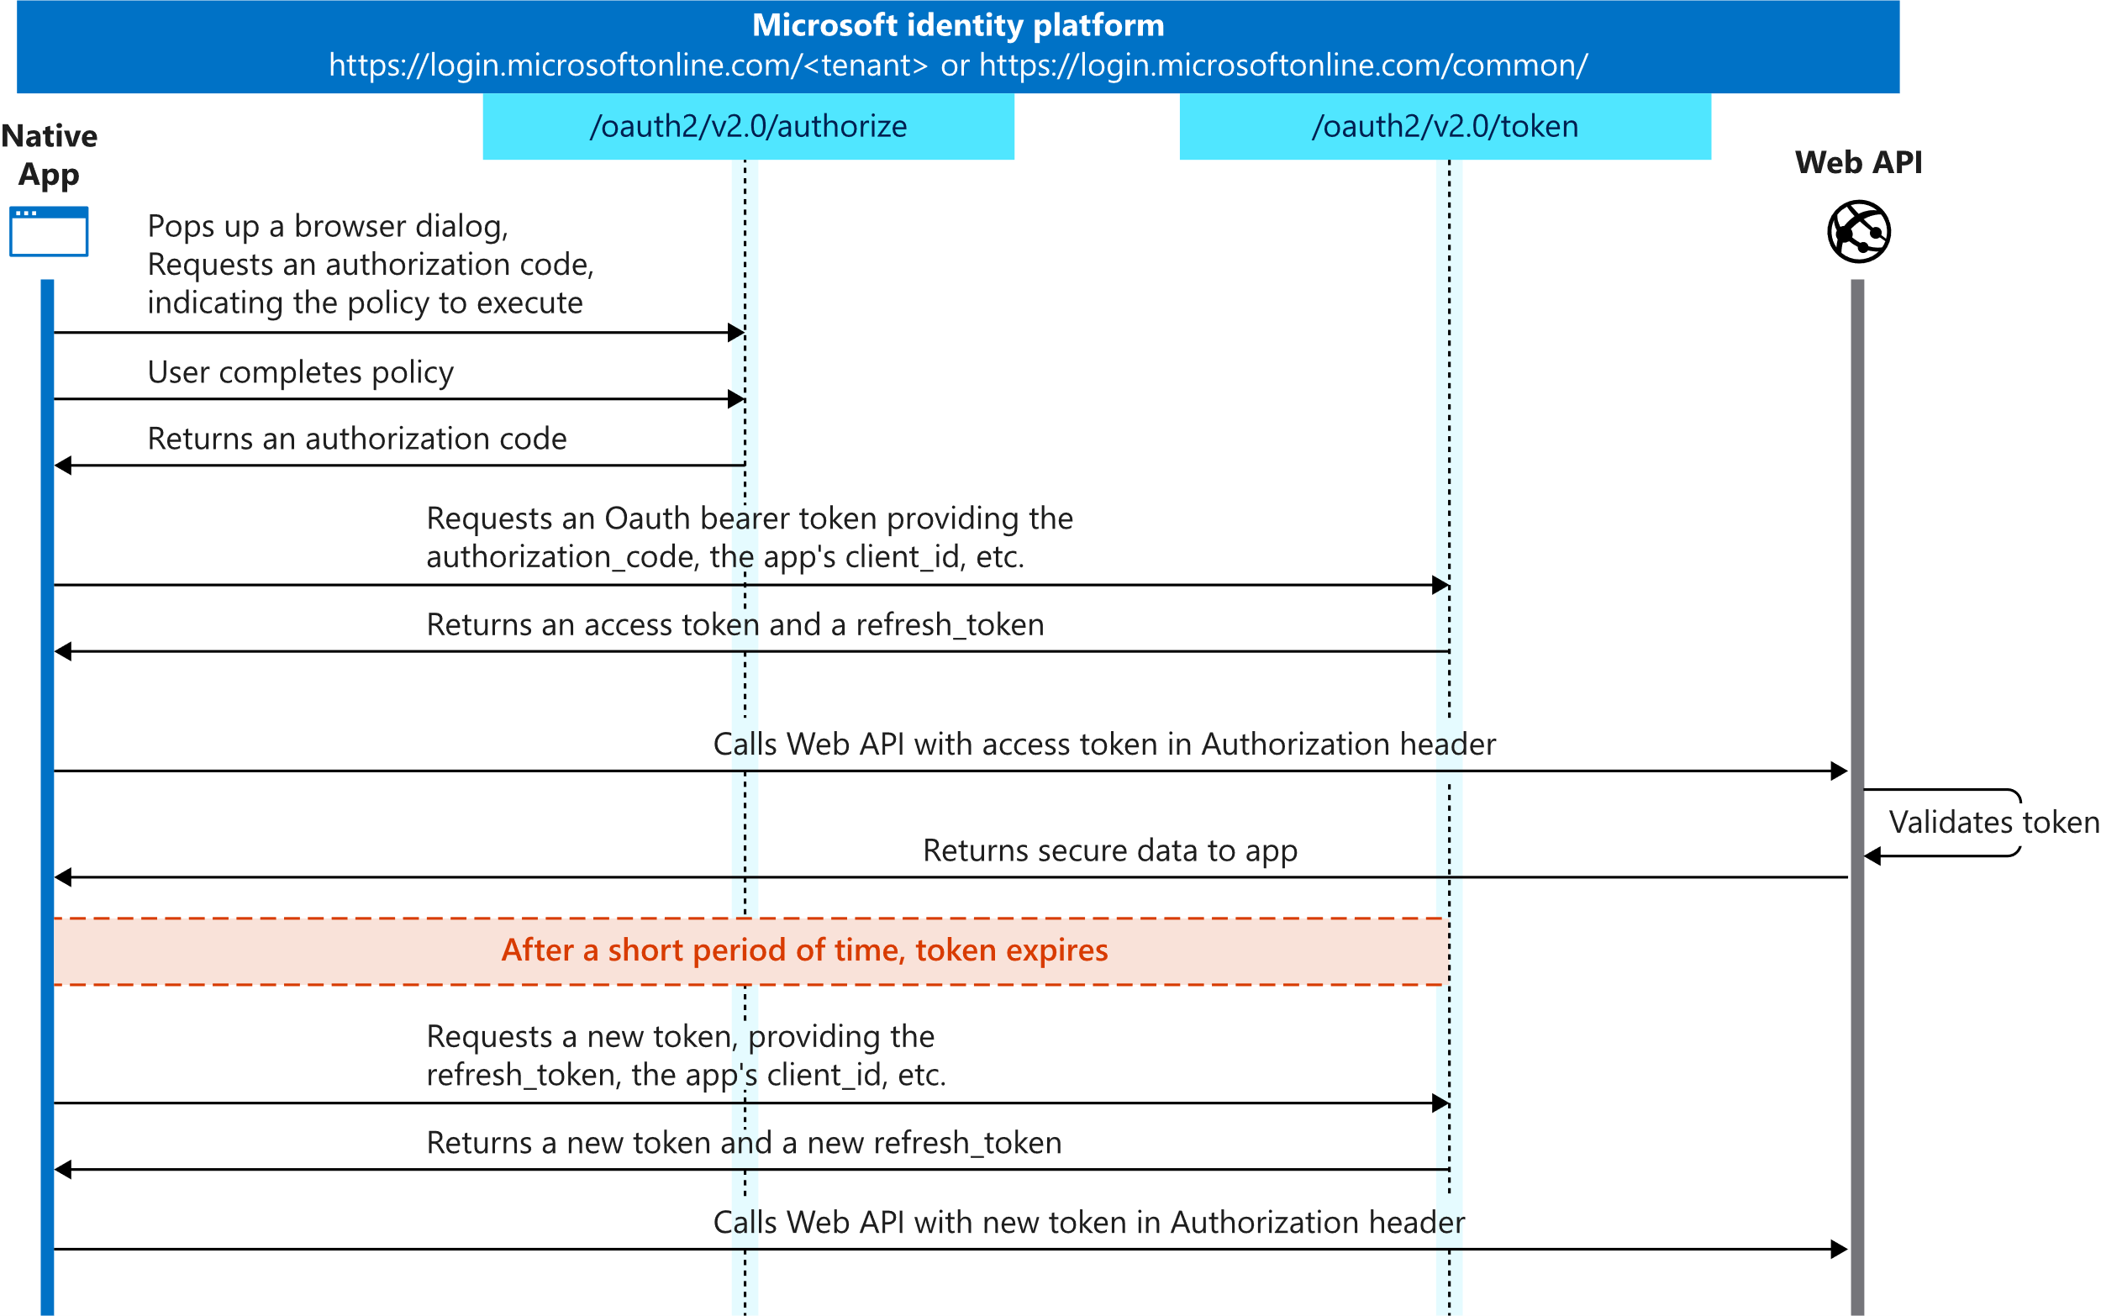
AUTHENTICATE TO GRAPH API
GRANT TYPES
Authorization_Code
Auth Request URL:
https://login.microsoftonline.com/{tenantID}/oauth2
/v2.0/authorize
?client_id={clientID}
&redirect_uri={RedirectURI}
&scope={Scope}
&response_type=code
Token Request POST Body:
Grant_Type = Authorization_Code
Client_ID = “{ClientID}”
Client_Secret = “{Client Secret}”
Scope = https://graph.microsoft.com/{permission.code}
Code = “{Authorization Code}”
Redirect_Uri = {Redirect URI in the Azure App}
24
Notes:
https://docs.microsoft.com/en-us/azure/active-directory/develop/v2-oauth2-auth-code-flow

Slide 25
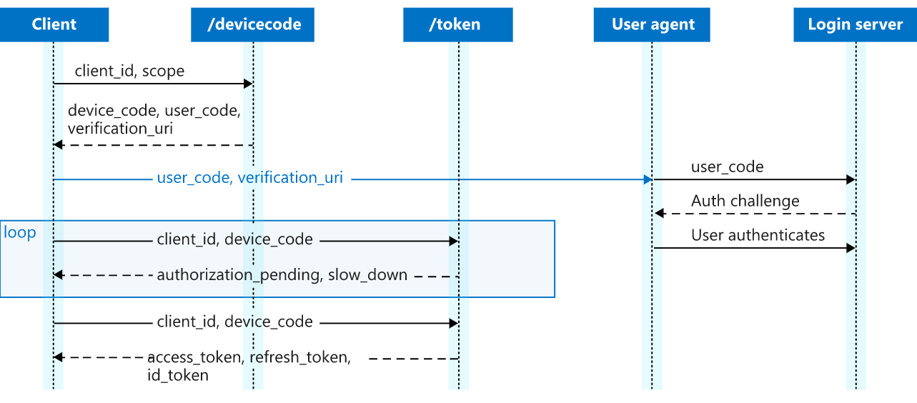
AUTHENTICATE TO GRAPH API
GRANT TYPES
Device_Code
Auth Request POST Body:
Client_ID = “{Azure App Client ID}”
Code = “{Device Code}”
Send to:
https://login.microsoftonline.com/{tenant}
/oauth2/v2.0/devicecode
Token Request POST Body:
Grant_Type = “Device_Code”
Client_ID = “{Azure App Client ID}”
Code = “{Device Code}”
25

Slide 26
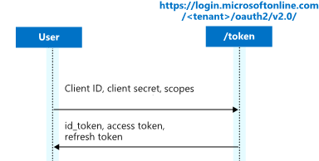
AUTHENTICATE TO GRAPH API
GRANT TYPES
\
Refresh_Token
Required POST Body:
Grant_Type = Refresh_Token
Client_ID = “{Azure App Client ID}”
Client_Secret = “{Azure App Client Secret}”
Refresh_Token = “{Refresh Token}”
Redirect_URI = “{Redirect URI}”
Scope = https://graph.microsoft.com/{permission.code}
26

Slide 27
GRAPH API INTERACTIONS
SENDING REQUESTS
Query Parameters
Filter results
Paging Results
Dealing with huge datasets
Batch Processing
Send multiple requests at ones
Graph API Endpoint
Where you will send your request
Root URL - https://graph.microsoft.com/v1.0/
Root URL - https://graph.microsoft.com/beta/
https://graph.Microsoft.com
/{version}
/{resource}
/{id}
/{property}
/{query-parameters}
27

Slide 28
GRAPH API INTERACTIONS
FILTERING QUERIES
Name | Description | Example
$count | Retrieves the total count of matching resources. | /me/messages?$top=2&$count=true
$expand | Retrieves related resources. | /groups?$expand=members
$filter | Filters results (rows). | /users?$filter=startswith(givenName,'J')
$format | Returns the results in the specified media format. | /users?$format=json
$orderby | Orders results. | /users?$orderby=displayName desc
$search | Returns results based on search criteria. Currently supported on messages and person collections. | /me/messages?$search=pizza
$select | Filters properties (columns). | /users?$select=givenName,surname
$skip | Indexes into a result set. Also used by some APIs to implement paging and can be used together with $top to manually page results. | /me/messages?$skip=11
$top | Sets the page size of results. | /users?$top=2
28

Slide 29
Microsoft Graph SDK
PowerShell Graph SDK
Key Benefits
Available from the PowerShell Gallery
Install-Module Microsoft.Graph
3219 different commands currently
Supports PowerShell 5.1+ (Windows and Core)
No requirement to create an Azure AD Application, the SDK will use it’s own baked-in application
Supports device code auth, so not reliant on Windows Forms or WPF to display sign-in/MFA prompts
Has built in authentication methods such as refreshing OAuth tokens automatically etc.
Prefix of mg (ex: get-mguser, get-mgusermessage)
29

Slide 30

Questions / Open Discussion
30

